Slide 1
Measures of dispersion
Dr. Vinit Kumar

Slide 2
Measure of central tendency gives us a single central value that represents the entire data.
But they do not reveal the degree of spread or extent of variability of individual items in a distribution.
Therefore the measure of central tendency is insufficient.

Slide 3
 | Maths | Computer | Science
Rahul | 40 | 50 | 60
Anjali | 20 | 50 | 80
Here,
The mean is same i.e, 50 Marks
But the performance of Rahul is better than anjali, since anjali failed in one subject
Also Rahul’s marks vary between = Mean -10 to mean +10
For Anjali it is = Mean -30 to mean +30
Such a variation present in data is measured through measures of dispersion.

Slide 4
graph

Slide 5
Definition
The degree to which numerical data tend to spread about an average value is called variation or dispersion of data.
Dispersion or spread is the degree of the scatter or variation of the variable about a central value.
Averages of second order.
Used in two senses:
Relates to the limits within which the data fall
Accounts to the amount, absolute of relative by which the values of the items differ from average.

Slide 6
Significance
To determine the reliability of an average
To serve as a basis for the control of variability
To compare two or more series with regard to their variability
To facilitate the use of other statistical measures, Such as correlation, regression etc.

Slide 7
Methods of studying variation
The Range
The mean deviation
The standard deviation
The variance

Slide 8
Absolute Measures of dispersion
Expressed in same statistical unit in which the original data are given such as Rs, KG, etc
Used to compare the variation in two distributions provided the variables are expressed in the same units and of same average size.
Relative Measures of dispersion
The ratio of a measure of absolute dispersion to an appropriate average.
AKA “Coefficient of dispersion”

Slide 9
Range
Simplest measure of dispersion
It is the difference between the minimum and the maximum item of the series.
20,21,22,25,30,32,37,47,65

Slide 10
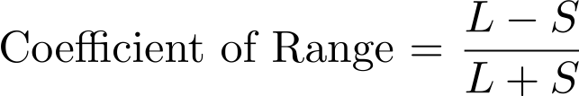
Absolute Range= Xmax-Xmin
=L-S
L= Largest Item, and
S= Smallest Item
Relative,
Coefficient of Range= Absolute Range/Sum of two extremes

Slide 11
So we can say,
If the average of the two distributions are same, a comparison of the range indicates that the distribution with the smaller range has less dispersion, and the average of that distribution is more typical of the group.

Slide 12
Ex.
The following are the books issued by The StatsLib in the last seven years.
Calculate the range and its coefficient.
Year | Books issued
2011 | 200
2010 | 210
2009 | 208
2008 | 160
2007 | 220
2006 | 250

Slide 13
For grouped data
Two methods:
Find the difference between the upper limit of the highest class and the lower limit of the lowest class.
Subtract the mid-point of the lowest class from the mid-point of the highest wage class.
In Practice both the methods are used.

Slide 14
Ex.
Calculate Coefficient of range from the following data.
Marks | No. of Students
10-20 | 8
20-30 | 10
30-40 | 12
40-50 | 8
50-60 | 4
60-10/60+10=50/70=0.714

Slide 15
Merits and demerits of Range
Merits:
Easiest to understand
Simplest and easy to calculate
Quick and dirty way to compute variability
Algebraic treatments can be applied.
Demerits:
Not based on each and every item of the distribution.
Subject to sampling fluctuations
Range only considers the extreme values, so it can’t tell us the character of the distribution.
Range cannot be computed in an open ended distribution

Slide 16
Ex.
Observe the following three series:
Series A | 46, 6, 46, 46, 46, 46, 46, 46
Series B | 6, 10, 6, 6, 46, 46, 46, 46
Series C | 6, 6, 15, 25, 30, 32, 40, 46
Here, in all the three series range is same, i.e., 46-6=40. but it does not mean that the distributions are alike.

Slide 17
Mean Deviation
The range an the interquartile range are not measures of dispersion in the strict sense of the term because they do not show the scatteredness/spread around an average.
The two other measures:
Mean deviation
Standard deviation
Will help us in achieving this goal.

Slide 18
Mean Deviation
Average deviation.
Mean deviation of a series is the arithmetic mean of all the deviations, without their algebraic signs, taken from its central value(Mean or median or mode)
“Average of the modulus of the deviations of the observations in a series taken from mean or median or mode”.

Slide 19
In other words
It calculates the variations of the value of individual items in the series:
The central value can be any average.
The sum of deviations of items from median is minimum.
In practice mean is more frequently used.
The algebraic signs of the deviations is always positive.
B’coz the sum of all deviation will always be ZERO.
3, 5, 13, 14, 15, 16

Slide 20

Computation
If x1, x2, x3, ….. Xn are n given observations then the deviation about the average is given by :
Disregarding the signs and considering only the absolute values it becomes:
And the sum of each deviation:

Slide 21
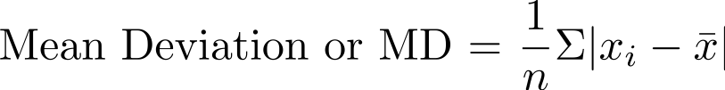
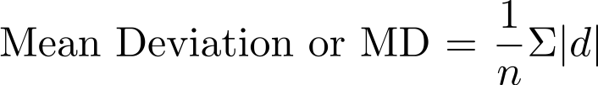
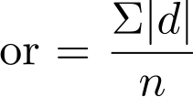

Slide 22
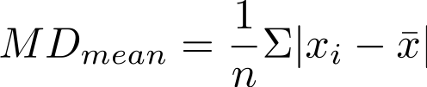
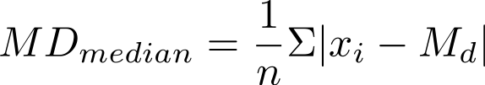
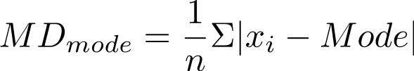

Slide 23
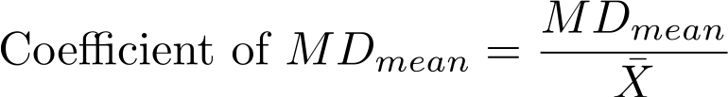
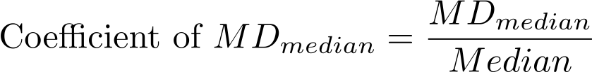
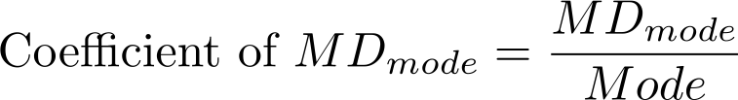
Coefficient of MD
The relative measure for mean deviation is known as “coefficient of Mean Deviation” and is obtained by dividing mean deviation by the particular average used in computing MD.

Slide 24
Ex
Calculate the Mean Deviation about the mean for the following series:
15, 20, 17, 19, 21, 13, 12, 10, 17, 9, 12
Steps:
Compute the mean of the series.
The deviations of the items from mean and denote it by “|d |”
Obtain the total of these deviations, i.e., ∑|d|
Divide the total obtained in last step by the number of observations.

Slide 25
X | X-Mean=d | |d|
15
20
17
19
21
13
12
10
17
09
12
N= |  | ∑|d|=

Slide 26
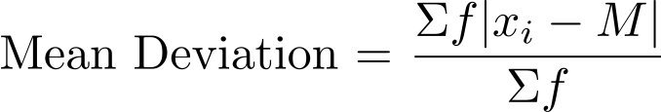
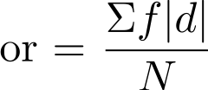
MD for grouped data
For x1,x2,x3, … xn occur with frequencies f1,f2,f3,….fn respectively.
M= Mean or Median or Mode

Slide 27
ex
Calculate the mean deviation about the mean for the following series.
X | 10 | 11 | 12 | 13 | 14
f | 3 | 12 | 18 | 12 | 3

Slide 28
ex
Calculate the mean deviation about the mean for the following series.
9,12,10,11,8,13,11,12,10,11,12,11,8,11,16,11

Slide 29
Assignment :
Calculate mean deviation about the median and its coefficient from the following data:
Class | Frequency
0-10 | 5
10-20 | 8
20-30 | 12
30-40 | 15
40-50 | 20
50-60 | 14
60-70 | 12
70-80 | 6

Slide 30
Variance
In mean deviation if we consider the signs the average distance from the mean will cancle to zero.
1,2 and 9.

Slide 31
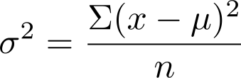
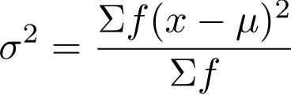
Another way to make the distances positive is by taking square of them.
We will always get a positive number and the average won’t cancel out. This kind of measure of dispersion is known as Variance.

Slide 32
Standard Deviation
Variance gives the spread in terms of distance squared. So it becomes tough to understand it.
So if we a take root of variance we will get spread which will be little more understandable.
Introduced by Karl Pearson
also known as root mean square deviation.
It is positive square root of the mean of the squared deviations from the arithmetic mean.
Denoted by small letter

Slide 33
Use
Measures the absolute dispersion (variability)
The greater the amount of dispersion the greater the standard deviation of the values from their mean.
A small SD means a high degree of uniformity of the observation as well as the homogeneity of the series

Slide 34
Thus if we have two or more comparable series with identical or nearly identical means, it is the distribution with the smallest SD that has the most representative mean.
SD is extremely useful in judging the representativeness of the mean.

Slide 35
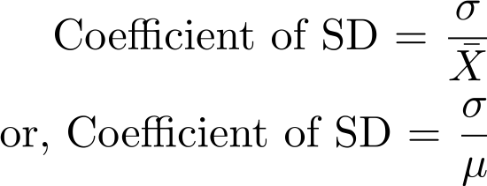
Coefficient of standard Deviation

Slide 36
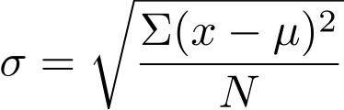
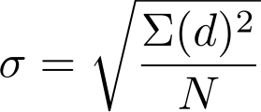
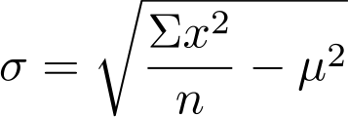
Calculation
For ungrouped data

Slide 37
Ex.
Find the standard deviation and variance of the following series:
3, 4, 5, 6

Slide 38
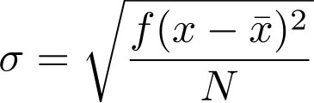
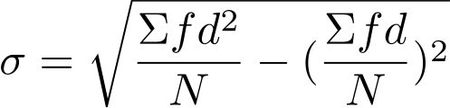
For grouped data
Actual Mean method or direct method
Assumed mean method
Here d= x-A
A = assumed mean
N= ∑f

Slide 39
Ex.
Find S.D. and coefficient of SD for the following
Size | 10 | 11 | 12 | 13 | 14 | 15 | 16
Frequency | 2 | 7 | 11 | 15 | 10 | 4 | 1

Slide 40
Working rule
Take any item of the given series as assumed mean A.
Take the deviations of the items from the assumed mean A and denote it by “d”.
Multiply the deviations by the respective frequency and denote it by fd. Obtain the total of this column.
Calculate d2.
Multiply the squared deviations by respective frequency to get fd2. Obtain the total of this column.

Slide 41
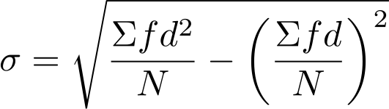
Find the value of

Slide 42
Size of the item | Frequency (f) | d=x-A | Fd | d2 | fd2

Slide 43
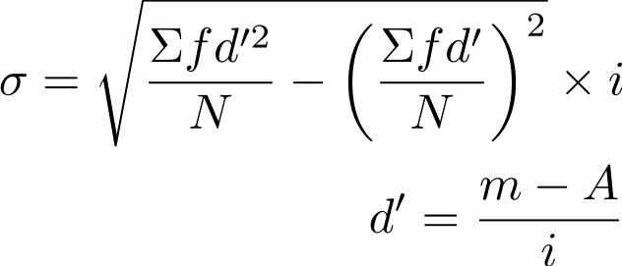
For Continuous series
i=class interval (or the common factor in case the class intervals are unequal)
m= mid value of the interval
A = Assumed mean

Slide 44
Working rule
Find the mid values or mid points of the various class and denote it by m.
Take any one value of ms as the assumed mean A.
Take the deviations of the mid-points from the assumed mean A and divide it by class interval or common factor i. Denote it by d’
Multiply the respective frequencies ‘f’ with the corresponding deviation d’ and obtain ∑fd
Square the deviations d’ and multiply it with their respective frequencies obtain ∑fd2
Put the values in the formula.

Slide 45
Ex.
Find the SD for the following distribution
Marks | 10-20 | 20-30 | 30-40 | 40-50 | 50-60 | 60-70 | 70-80
No. of Students | 5 | 12 | 15 | 20 | 10 | 4 | 2

Slide 46
Marks (class interval) | No. of student | mid-value (m) | d=m-A/i | fd | fd2

Slide 47
Assignment
Find the SD for the following data:
CI | 0-10 | 10-20 | 20-30 | 30-40 | 40-50 | 50-60 | 60-70
f | 6 | 14 | 10 | 8 | 1 | 3 | 8

Slide 48
The SD enables us to determine, with a great deal of accuracy, where the values of a frequency distributions are located with the help of Tchebycheff’s theorem.
It says: No matter what the shape of the distribution is, at least 75 % of the values will fall within ±2 SDs from the mean of the distribution,
And at least 89 % will lie in ±3 SDs from the mean.

Slide 49
For a symmetrical distribution, the following relationships hold good:
Mean ±1 covers 68.27% of the items.
Mean ±2 covers 95.45% of the items.
Mean ±3 covers 99.73% of the items.

Slide 50
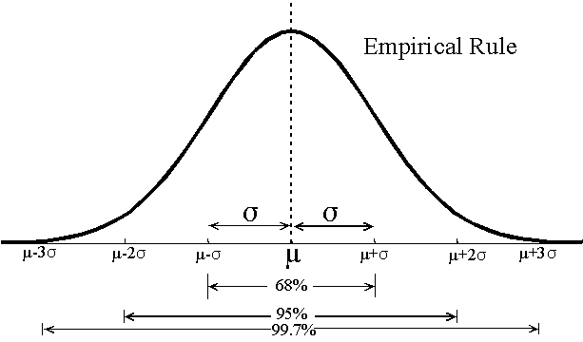

Slide 51

Coefficient of variation
Relative measure of dispersion.
It is always in percentage.
Used to compare the variability of two series.
The series for which CV is greater is said to be more variable (or less consistent)

Slide 52
The quarterly circulation of three libraries are given below.
 | A | B | C
Jan-March | 9.5 | 15.5 | 3.3
April-June | 13.7 | 21.2 | 5.7
July-Sept | 10.4 | 23.4 | 8.9
Oct-Dec | 8.6 | 18.8 | 2.6

Slide 53
The arithmetic means of entries prepared by three cataloguers Jay, Viru and Gabbar in the StatsLib are 50, 48, 12 respectively.
The SD of their efficiencies are 15, 12, 2. Who is most consistent cataloguer? Who should be promoted?

Slide 54
Thanks
Send your queries to :
mailvinitkumar@gmail.com

